Slide 1
What Is the Metaverse, Exactly?
By Hassan ahmed

Slide 2

Tech Companies on Metaverse
Facebook, Microsoft and a host of other companies are jockeying to define the next iteration of the internet.

Slide 3
Money Flow in Metaverse
What's for sure is that if there's money to be made, big companies will be involved. In addition to Microsoft and Meta, Qualcomm, Nvidia, Valve, Epic, HTC and Apple are all dreaming up new ways of connecting online. So you'll be hearing more about the metaverse in the years ahead
Microsoft's planned acquisition of ActivisionBlizzard for $69 billion, was explained as part of an expansion into metaverse. Last year, Facebook rebranded itself as Meta, a nod to the social network's ambition to be a prime mover in the new world. Rec Room and world-building games, like Roblox and Minecraft, all get rolled into discussions of what the metaverse is or will be

Slide 4
What is the metaverse?
You've probably heard the hype: the metaverse is going to change the way you live.
A vision for the next step in the internet's evolution, the metaverse refers to digital worlds in which people will gather to work, play and hang out. Some of those online spaces will be immersive 3D experiences and require fancy goggles to enjoy. Others will play out on a computer screen. The term's been in flux, and might still keep evolving and renaming itself

Slide 5
Conclusion
Tech hype cycles come and go. The metaverse could fizzle before it's even realized. As of yet, however, interest continues to grow. Across gaming, NFTs and shopping, it's become a repeated buzzword
Our best guess – and it's just a guess – is that the metaverse will start as a slate of competing platforms, each laying claim to being the metaverse.

Slide 6
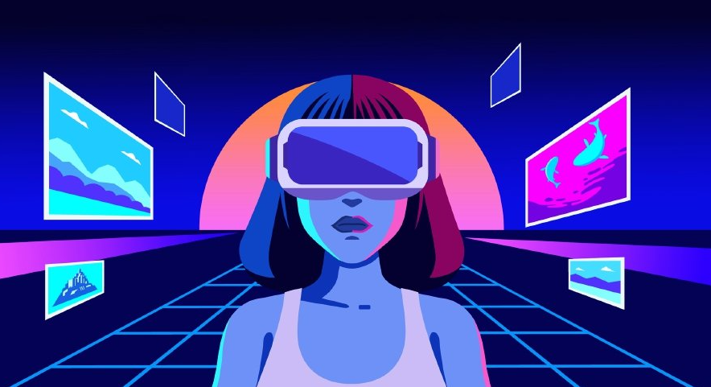
Will there be one metaverse? Or many metaverses?
That remains to be seen. No standards for the metaverse exist and lots of companies are clamoring to lay the groundwork others will follow. Facebook, Microsoft, Sony, Epic Games and a bunch of smaller companies are all working on projects with the hopes of grabbing first-mover advantage. It's unclear whether one company's VR headset will be compatible with another company's expansive multiplayer world or cloud-based graphics. Most companies promise a metaverse that allows other companies in. But that requires them to agree on how they work together

Slide 7
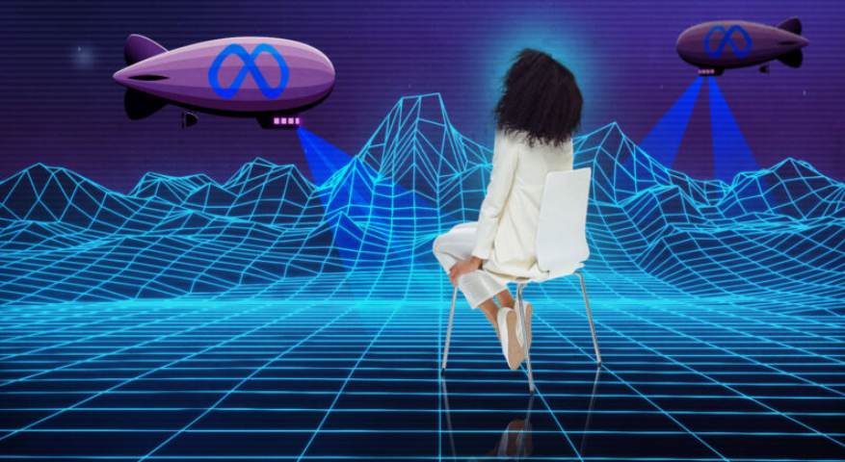
What will it be like in the metaverse?
The idea behind the deluxe Metaverse – the one that requires a headset – is an immersive, 360-degree digital world. You'll have your own avatar, which you'll be able to design, and you'll own digital assets, the titles of which will likely be recorded on a blockchain. Some think you'll buy plots of digital land and build online houses, in which you can entertain your friends (or at least their avatars).

Slide 8
THANKYOU!

